Slide 1
Rocket Math Team
Members: Samuel Arseneault, Kelly Markaity, John Luu

Slide 2

What is Rocket Math?
Notes:
The rocket math project is the idea of having first grade students learn their math facts with an iPad. The students will interact with our Rocket Math app, and they will be asked to solve basic math problems. The difficulty of the basic math problems will be split into levels, which become increasingly harder as the students master each level. Once a level is mastered they will be able to move on to unlock new levels. While the students are solving these math problems, the statistics on their performance will be tracked. The data the students generate with this application would then be used to inform teachers how well their class is performing.The teachers will log onto an online portal, where they can view each individual student’s record or the class as a whole.The Rocket Math project will essentially be micro data mining first grade students to help track and improve their math skills.

Slide 3
Scope
Exercise first grade math skills
Track student’s data
Create an IOS application
Create a database
Create an online portal
Notes:
The rocket math project will include implementing an IOS application from scratch, implementing a database to store gathered information from the application, and creating an online portal to view the logged information.

Slide 4
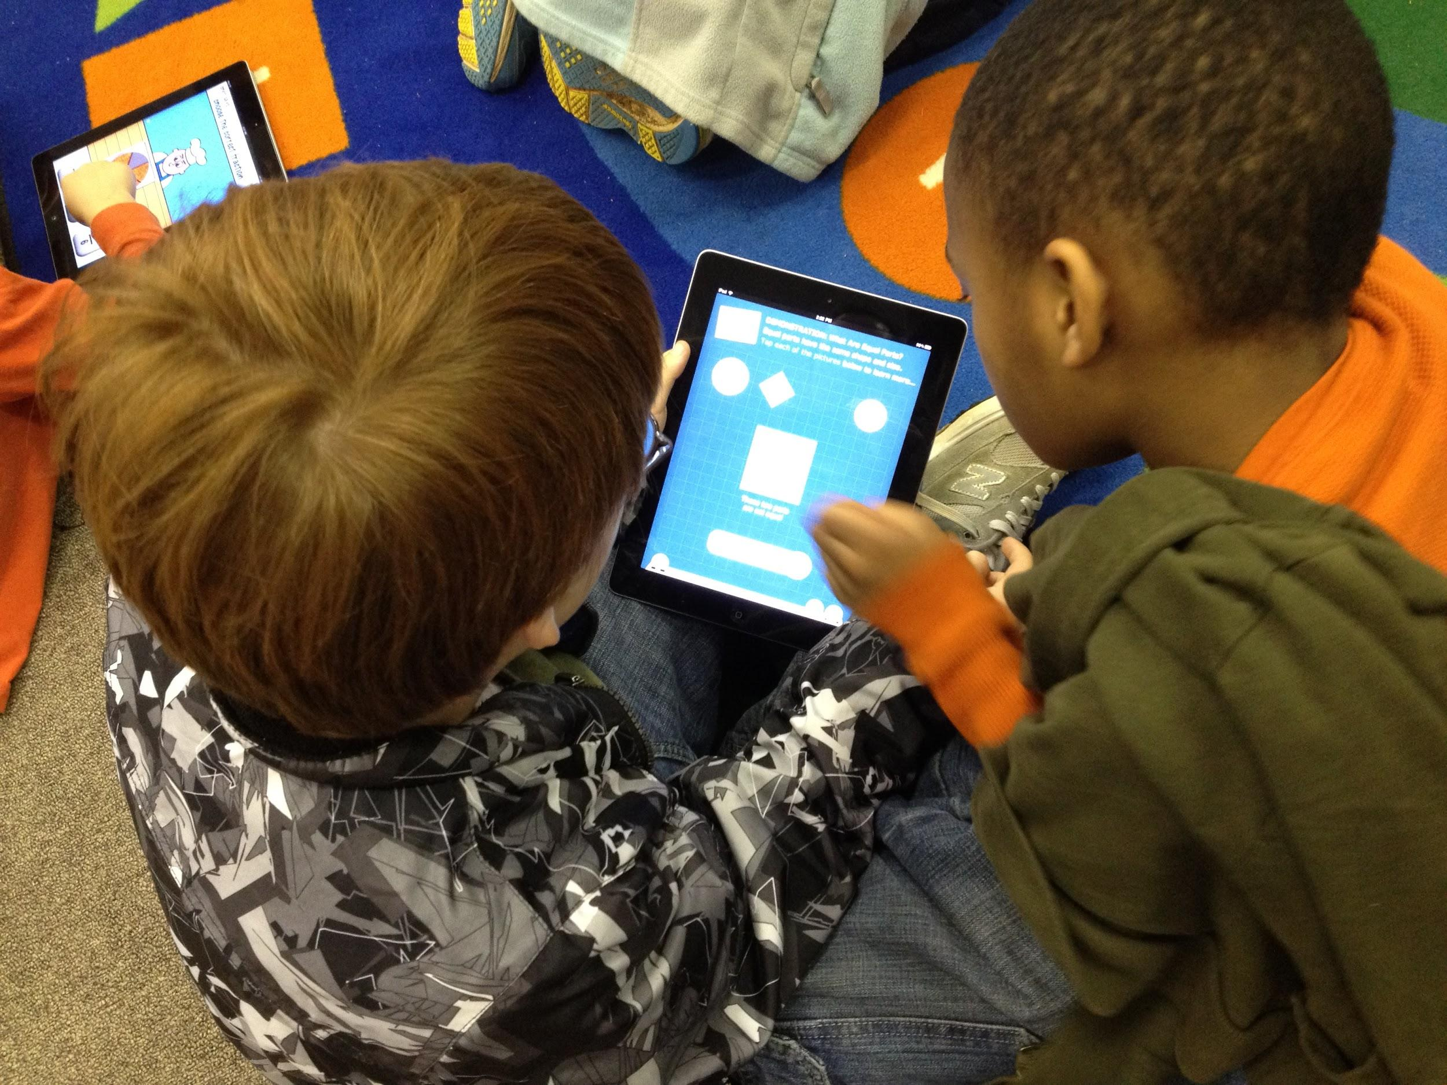
The IOS Application
Notes:
Again the IOS application will be where the students interact with the solvable math facts. This will include 0,1,2,… rules for addition, subtraction, multiplication, and division.

Slide 5

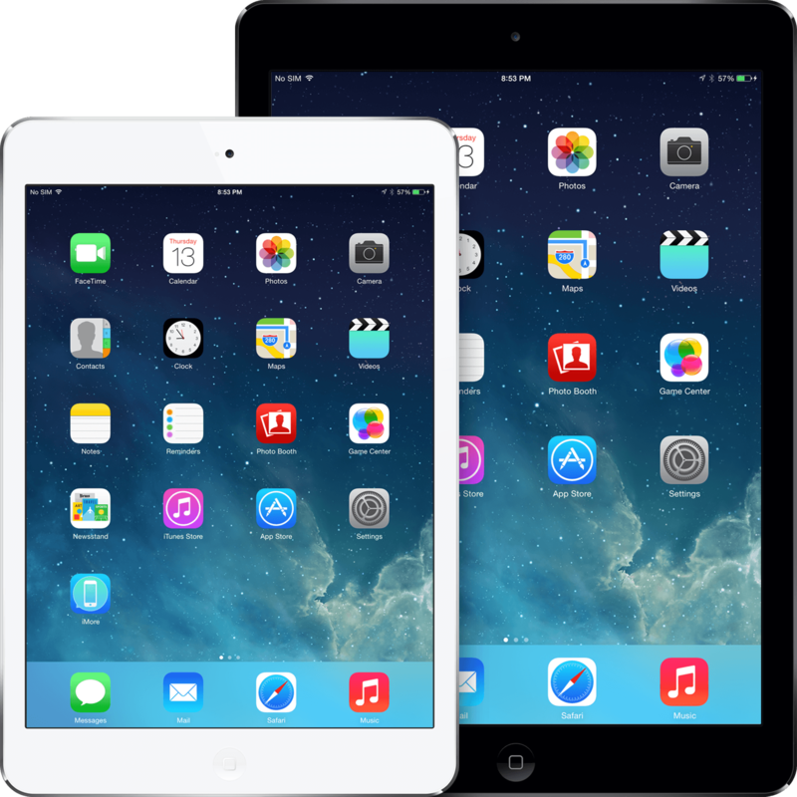
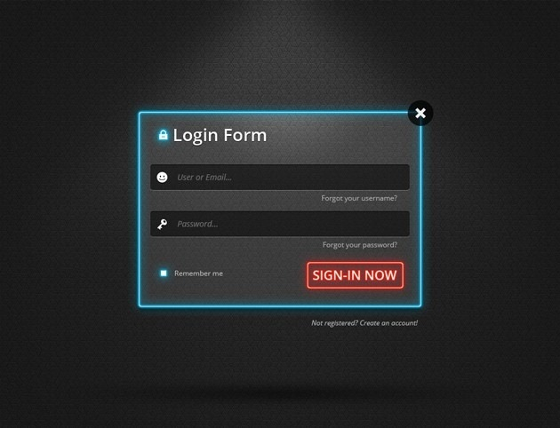
Behind the Scenes
Notes:
This is the basic idea of how it will work. Students will play our Rocket Math app on their iPads, and then their tracked data will be constantly streamed to a server. The type of data tracked will be number of questions right/wrong, time spent on question, top 3 struggling math fact. Later on when a teacher is ready to review their students’ records, they will have an online login portal where they can access the data based. We also have plans to offer a settings menu in the online portal. The teacher would be able to modify the behavior of the app through the site, such as difficulty of math problems, or occurrence of math problems.

Slide 6
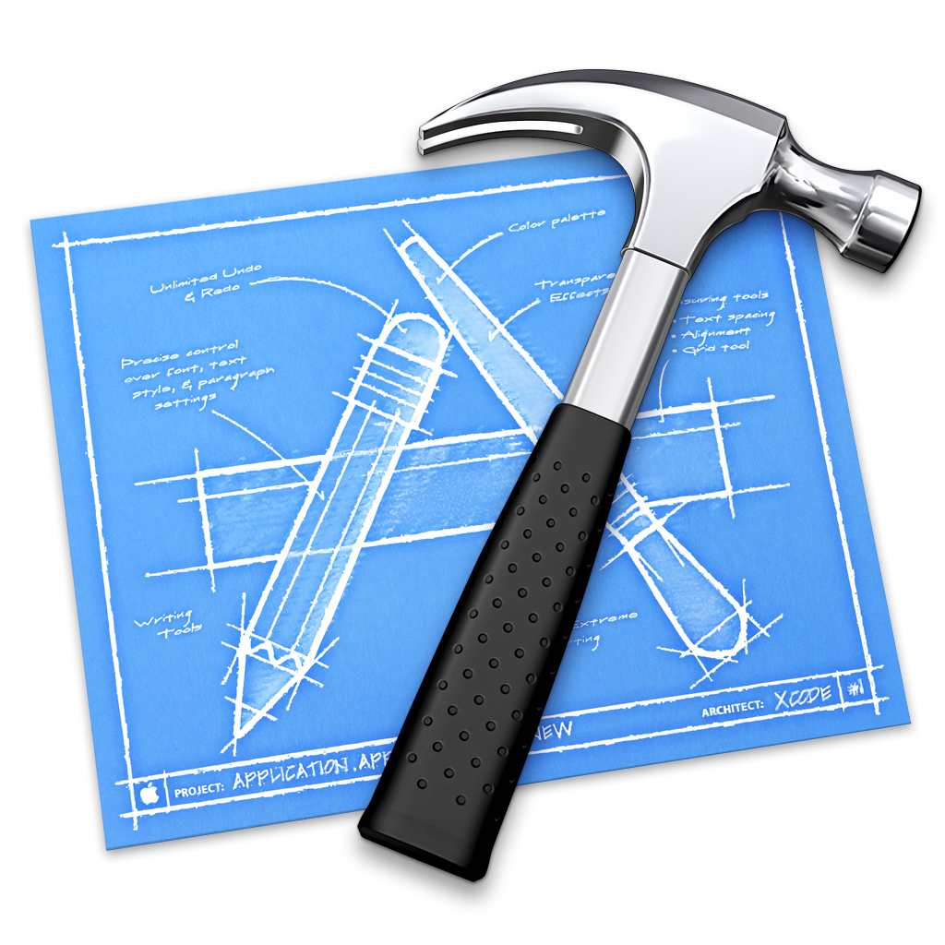



Technology
Objective-C
Notes:
The technologies we will touch are Objective-C, MySQL, PHP, HTML, CSS and JavaScript. Since the first grade students will all have iPads, our only languge option for programming the IOS app is Objective-C; this is also stated in the project requirements. For our database we chose MySQL because of its popularity. Since our team has limited experience with databases, we wanted to use a technology that would have plenty of tutorials to guide us. We chose PHP for our server side scripting language because it appears to be fairly easy to learn, theres an active community, there is a lot of built into the language, and the main reason is because it’s cross platform. We feel this is important because when switching from Mac OSX to windows or unix we wanted something where we could commit code from any platform. For our website design we chose HTML, CSS, and JavasScript because we are familiar with these languages and again for its popular.

Slide 7


Team Structure
Samuel Arseneault
Project lead
John Luu
Team member
Kelly Markaity
Team member
Notes:
The team lead is responsible for organizing client meetings, team meetings, and following up with team members to ensure the team is synchronized and always on track.
The team lead is also responsible for quality assurance.
John Luu -> Documentation, Testing/Debugging:
Kelly Markaity -> Front end, Architecture planning:
Samuel Arseneault -> Back end, Quality Assurance

Slide 8

Problem Resolution
Notes:
Our team will be using a three strike rule. A strike is considered absent work, poor quality of work, or poor communication. If a team member receives a strike, this means the rest of the team will have to make up the work the violating member did not deliver. Once a team member receives three strikes, we will inform the instructor and TA of the incident. If a team member is still uncooperative after three strikes we will set up a meeting with our instructors and TA.

Slide 9





Tools and Mediums
Notes:
Our team we will be using Skype, Google Drive, Google Hangouts, and Github/Sourcetree.
Since our client is 3 hours away we had to resort to web meetings. We chose skype for this because our client has had experience with this tool.
We will be using Google Drive and Google Hangouts to keep our team organized and updated on team documentation. We like Google Drive because we can edit documents simultaneously and resolves the microsoft office format issues.
For our repository/version control system we will be using GitHub in combination with SourceTree. All of these tools are convenient because they are cross platform, and very user friendly.

Slide 10
Schedule
Task: | Date:
Project introductory meeting | Saturday, January 24th
Requirements Meeting | Tuesday, February 3rd
Team Requirement Deadline | Tuesday February, 10th
Requirement Presentation | Tuesday February, 17th
Team First Prototype Deadline | Tuesday February, 24th
First Prototype Deadline | Tuesday March, 3rd
Notes:
Our team has broken up our important dates into tasks. For every major task deadline we have set up our schedule so it will be completed one week prior to the actual due date. For example if you look at the Requirement Presentation due on Tuesday February, 17th, we have a Team Deadline 1 week before this due date (on February 10th).
This goes for the First prototype Deadline...

Slide 11
Schedule Continued...
Task: | Date:
Have IOS Application Submitted to Apple Store | Tuesday March, 3rd
Design Specification Presentation | Tuesday March, 10th
Team Test Plan Deadline | Tuesday March, 17th
Test Plan Presentation | Tuesday March, 24th
Second Prototype Deadline | Tuesday March, 31st
Final Project Presentation | Tuesday April, 21st
Notes:
… Test plan, and second prototype deadline. In addition to the early Team Deadlines we also wanted to make sure our IOS application would have enough time to become approved on the Apple Store. We have read it usually takes about 1 - 2 weeks for an application to become approved. Therefore we have set a deadline on March 3rd to have the IOS app submitted to the app store. This leaves us about 7 weeks before the final project presentation.

Slide 12

Summary
Notes:
Although, there are alternative basic math solving applications already on the market, but what they do not offer is a way for teachers to log their students progress. Our system will constantly be logging information generated by the first grade students. This will be important for teachers to understand exactly what math facts their students are struggling with, and it will be useful for teachers to show parents their child’s progress. This is the major proprietary feature we are offering, but our client has also conveyed to us that other apps contain many distracting animations, and the math facts are not randomized they way she would like it.

Slide 13
After Rocket Math
Rocket english
Rocket science
Rocket social studies
Notes:
After our work with rocket math, we vision this project growing its product line. Rocket math could be transposed to other subjects students are learning, such as rocket english, rocket science, or rocket social studies. We also vision this to be used with second graders, third graders, and other classes in throughout the elementary. Although these new branches are not in our planned schedule, we will try our best to implement this project with high extensibility.

Slide 14

Questions?

